Slide 1


MOOD SWINGS PREDICTION IN MENTAL HEALTH DATASET
​School of Engineering & Applied Science, George Washington University

Slide 2

Agenda
MOOD SWINGS PREDICTION IN MENTAL HEALTH DATASET
Introduction
our approach
Experiment results and Discussion
Proposed Approach Overview
DATA COLLECTION
DATA CLEANING & PREPROCESSING
EXPLORATORY DATA ANALYSIS
DATA ENCODING
MODEL DEVELOPMENT
VALIDATION
FINAL OBSERVATIONS
Conclusion
This Photo by Unknown Author is licensed under CC BY-SA

Slide 3

Introduction
MOOD SWINGS PREDICTION IN MENTAL HEALTH DATASET
Mood swings are a significant symptom in many mental health conditions, including major depressive disorder, bipolar disorder, and borderline personality disorder. Their abrupt and frequently unanticipated nature makes accurate prediction and prompt diagnosis crucial for effective management and treatment.
Traditional methods for diagnosing mood swings often depend on subjective self-reports and professional observations, which may not consistently capture the dynamic and complex nature of mood fluctuations.
The integration of machine learning in healthcare opens new avenues for improving diagnostic accuracy and intervention strategies. Machine learning's ability to process large datasets and detect intricate patterns offers a promising method for understanding and forecasting mood swings based on empirical data.

Slide 4




OUR APPROACH
We utilized data from the Mental Health Dataset, available on Kaggle at https://www.kaggle.com/datasets/bhavikjikadara/mental-health-dataset, a comprehensive source of self-reported mental health markers and demographic information, to predict mood swings in various mental health conditions.
Key Objectives:
Develop and evaluate a machine learning model capable of predicting mood swings by analyzing a comprehensive Mental Health Dataset, bridging the gap between traditional subjective assessment methods and objective, data-driven approaches.
Model Structure:
Engage in feature engineering to identify and construct relevant features with strong predictive power for mood fluctuations.
Tested different base classifiers, including LinearSVC, Logistic Regression, Naive Bayes (NB), Random Forest (RF), and XGBoost.
Approach to Model Selection:
Compared base classifiers to find the best model for our specific predictions.
Considered metrics like accuracy, precision, and recall to evaluate model performance.
MOOD SWINGS PREDICTION IN MENTAL HEALTH DATASET

Slide 5


Experiment results and Discussion
MOOD SWINGS PREDICTION IN MENTAL HEALTH DATASET
Objective:
Develop a robust model that enhances Mood Swings Prediction by leveraging Multi-Output Classification techniques.
5

Slide 6

Proposed Approach Overview
MOOD SWINGS PREDICTION IN MENTAL HEALTH DATASET
Data CLEANING AND Preprocessing
EXPLORATORY DATA ANALYSIS
Model Development
Validation
Clinical Integration
Clean and standardize Mental Health dataset for analysis.
Identify patterns and potential indicators in the data that correlate with mood swings.
Apply machine learning to predict treatment outcomes based on multi-feature profiles.
Test model accuracy with unseen data sets.
Translate model predictions into actionable treatment recommendations.
This step is a future step, and I have not worked on it.

Slide 7

DATA COLLECTION
MOOD SWINGS PREDICTION IN MENTAL HEALTH DATASET
From Kaggle, hosting a variety of mental health studies:
https://www.kaggle.com/datasets/bhavikjikadara/mental-health-dataset
DATASET DESCRIPTION
The dataset focuses on various indicators relevant to mental health conditions and their impact on mood swings.
Timestamp: Indicates the day and time when the answer was sent in. Later on, this field was eliminated from the dataset because it adds nothing to the understanding of mood swings.
Gender: The respondent's gender (e.g., Male, Female, Other), which is essential for examining patterns among various gender groups.
Country: The respondent's home country, which highlights the dataset's geographic diversity.
Occupation: Provides insight into the professional background of the respondents, which might correlate with their mental health due to different stress levels associated with various occupations.
self_employed: This field indicates if the responder works for themselves, which may have an effect on stress levels and mental health.
family_history: Indicates if mental health problems have a documented family history.
treatment: Is the responder presently undergoing mental health treatment?
Days_Indoors: A measurement of the respondent's average number of days spent indoors, which may be a sign of social disengagement or depressed symptoms.
Growing_Stress, Changes_Habits, Mental_Health_History, Mood_Swings, Coping_Struggles, Work_Interest, Social_Weakness: These fields record different facets of mental health symptoms and behaviors, such as stress levels, mood swings, coping mechanisms, interest in work, and capacity for social interaction.
mental_health_interview: The willingness to talk about mental health during a job interview, indicating the stigma that is both societally and individually attached to mental health.
care_options: The respondent's knowledge and accessibility of mental health care options, a sign of their access to mental health services

Slide 8
DATA CLEANING & PREPROCESSING
MOOD SWINGS PREDICTION IN MENTAL HEALTH DATASET
Handling Missing Values:
Focused on the ‘self_employed’ column which had 5193 missing values.
Imputed missing values in ‘self_employed’ with the mode (most frequently occurring value) to maintain consistency across the dataset.
Removing Duplicate Data:
Identified and removed duplicate rows to ensure data integrity and prevent skewing of results.
Maintained unique entries to accurately represent the respondent population.
Removing Irrelevant Data:
Removed the ‘Timestamp’ column as it provided no relevant information for the analysis of mood swings.
The dataset comprised of 292364 rows and 17 columns. As the initial dataset was already in a largely usable state with other preprocessing steps completed prior to our access, the data reduced to 290051 rows and 16 columns.
8

Slide 9
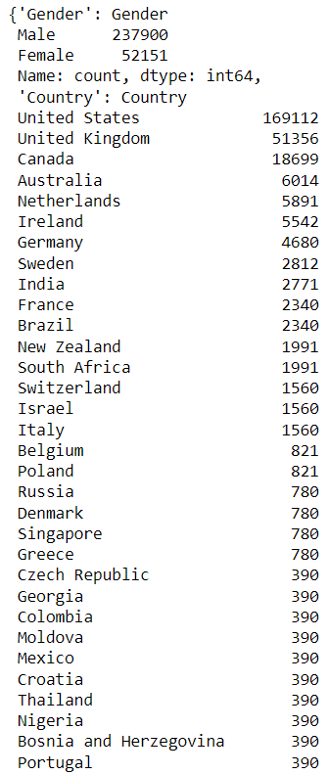
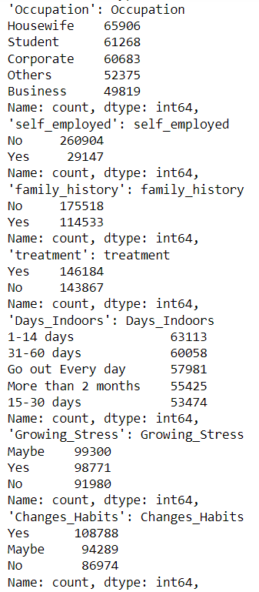
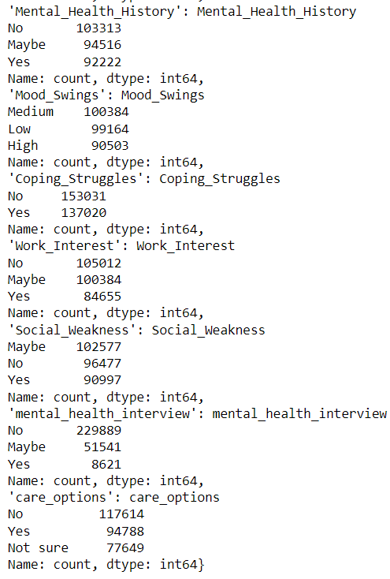
EXPLORATORY DATA ANALYSIS
MOOD SWINGS PREDICTION IN MENTAL HEALTH DATASET
Unique Values Count of Categorical Columns

Slide 10
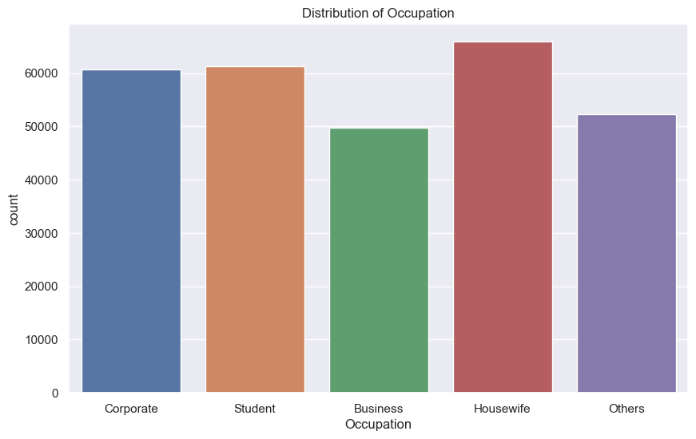
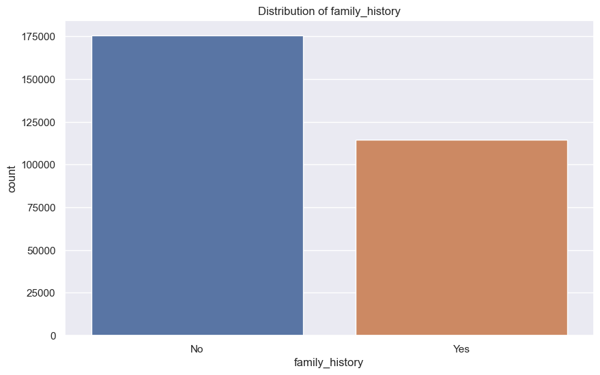
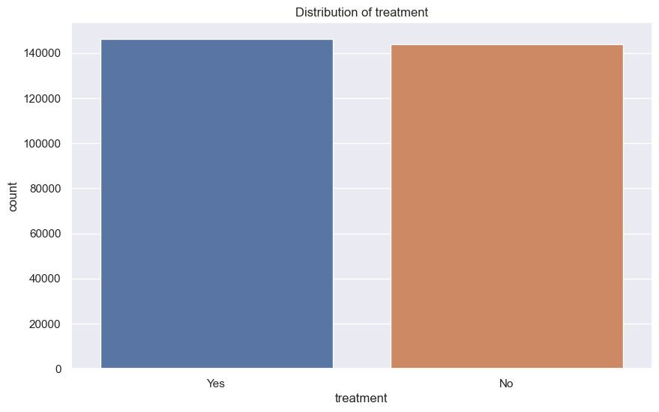
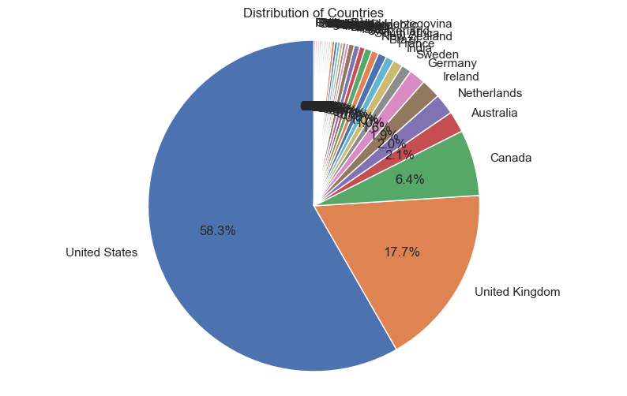
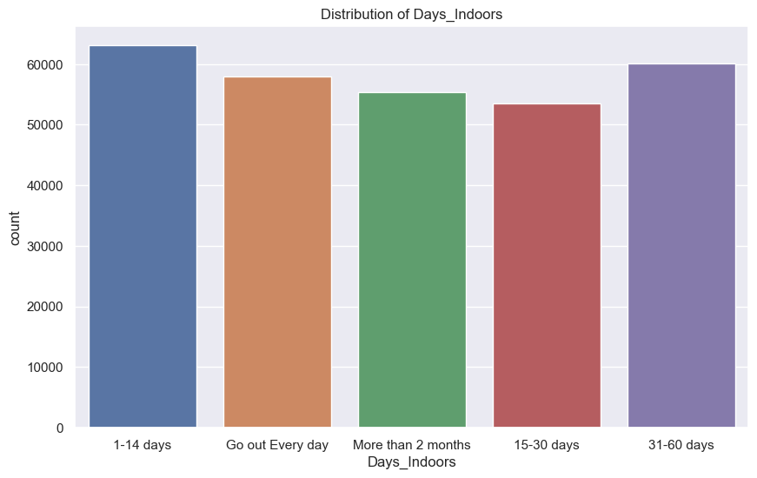
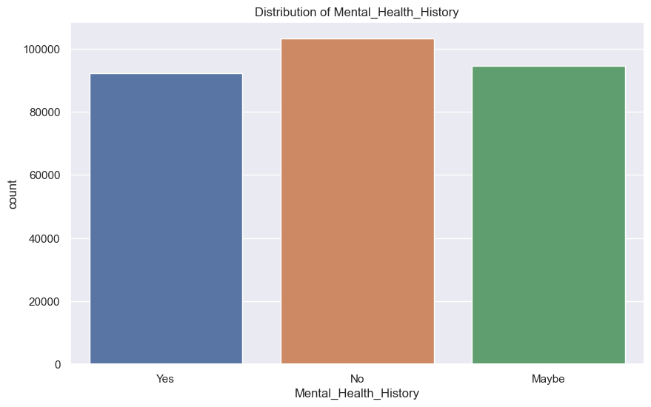
EXPLORATORY DATA ANALYSIS
Column Distributions
MOOD SWINGS PREDICTION IN MENTAL HEALTH DATASET

Slide 11
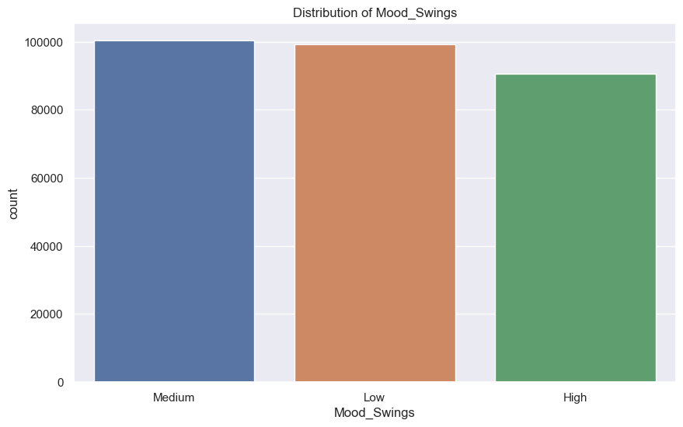
EXPLORATORY DATA ANALYSIS
MOOD SWINGS PREDICTION IN MENTAL HEALTH DATASET
Distribution of Target Column – Mood Swings

Slide 12
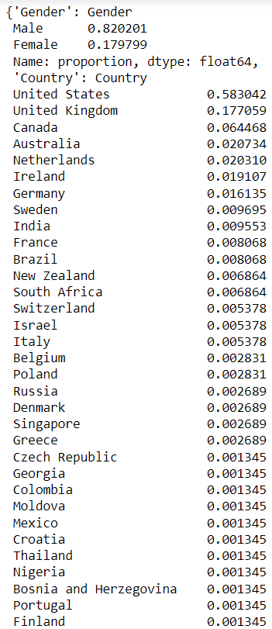
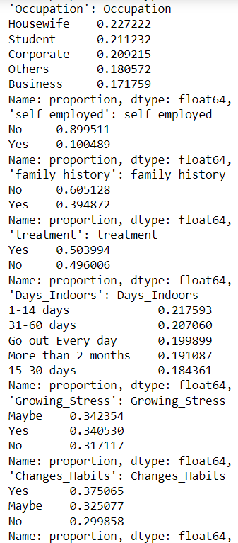
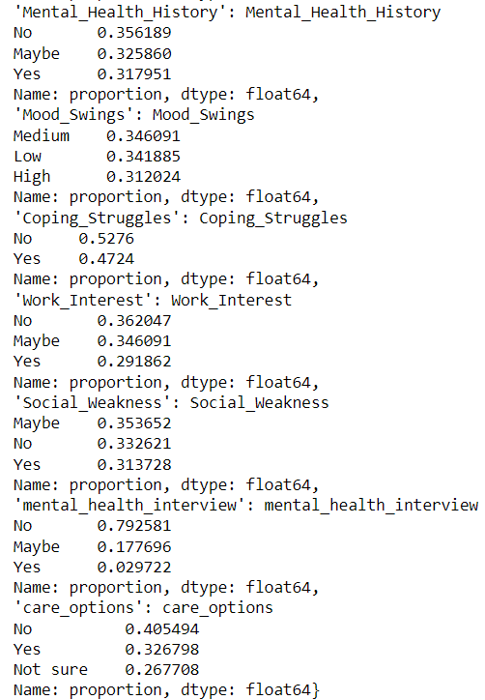
EXPLORATORY DATA ANALYSIS
Proportions of Unique Values Count of Categorical Columns
MOOD SWINGS PREDICTION IN MENTAL HEALTH DATASET

Slide 13

DATA ENCODING
MOOD SWINGS PREDICTION IN MENTAL HEALTH DATASET
Label Encoding:
Applied LabelEncoder from to transform categorical variables such as "Gender", "self_employed", "family_history", "treatment", and "Coping_Struggles" into unique integers.
Leave-One-Out Encoding:
Implemented LeaveOneOutEncoder for the "Country" column to manage high cardinality with minimal data leakage. This technique replaces each categorical value with the mean target value of all other samples where the category appears.
One-Hot Encoding:
Utilized pd.get_dummies() to encode columns with non-ordinal categorical data such as "Occupation", "Days_Indoors", "Growing_Stress", "Mental_Health_History", "Work_Interest", "Social_Weakness", "mental_health_interview", and "care_options". This approach creates a binary column for each category and is ideal for nominal variables where no ordinal relationship exists.

Slide 14
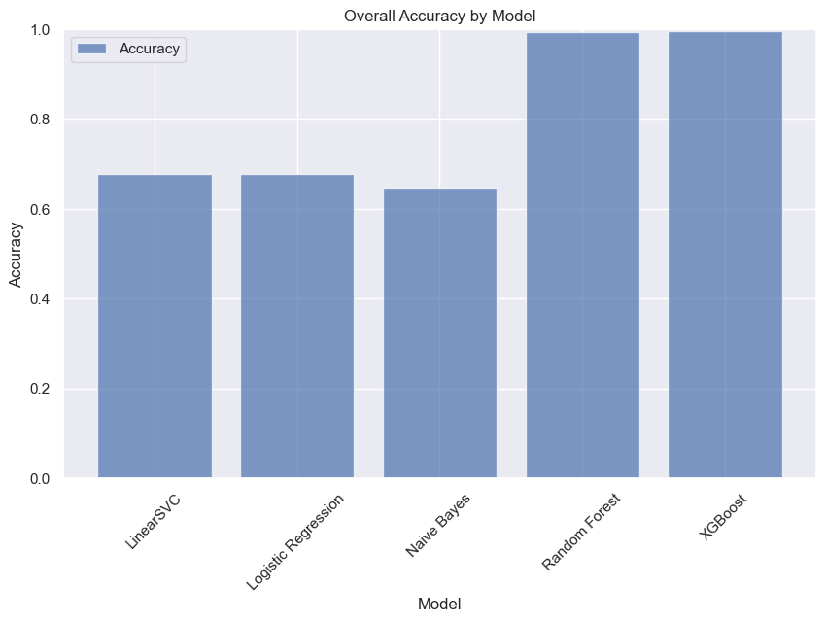
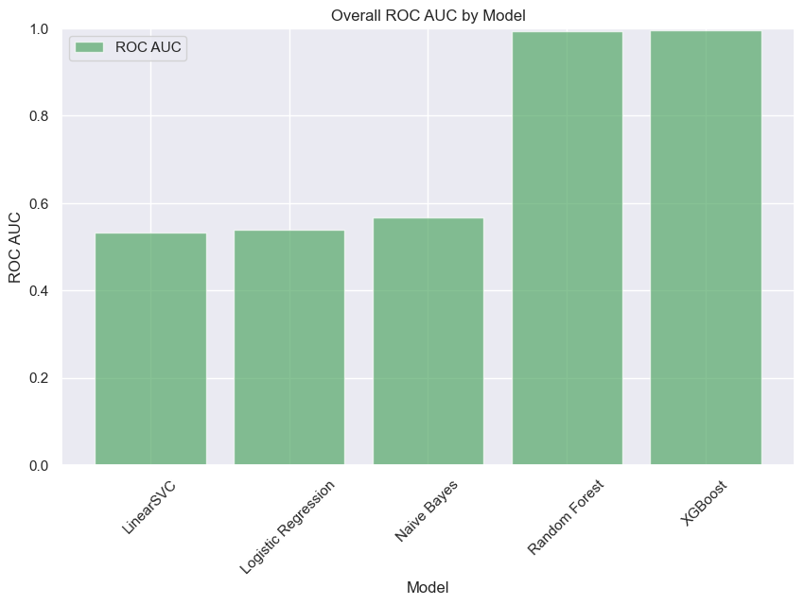
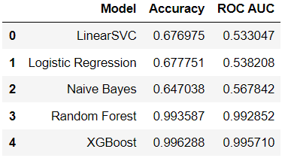
MODEL DEVELOPMENT
MOOD SWINGS PREDICTION IN MENTAL HEALTH DATASET
Multi-Output Classification: Developed a MultiOutputClassifier to predict multiple target columns simultaneously, addressing the problem of correlated outputs in the dataset.
Base Classifiers: Implemented various base classifiers, such as LinearSVC, Logistic Regression, Naive Bayes, Random Forest, and XGBoost, to determine which yielded the best performance in the multi-output scenario.
Model Evaluation: Evaluated the models using key metrics like accuracy, and ROC AUC values. This approach helped identify the most effective base classifier for the specific prediction task.
Model Selection: After comparing the base classifiers' performance, the model with the optimal balance of accuracy, precision, and recall was selected for further development and tuning.
The Resultant Model Comparison Table
14

Slide 15

MOOD SWINGS PREDICTION IN MENTAL HEALTH DATASET
VALIDATION

Slide 16
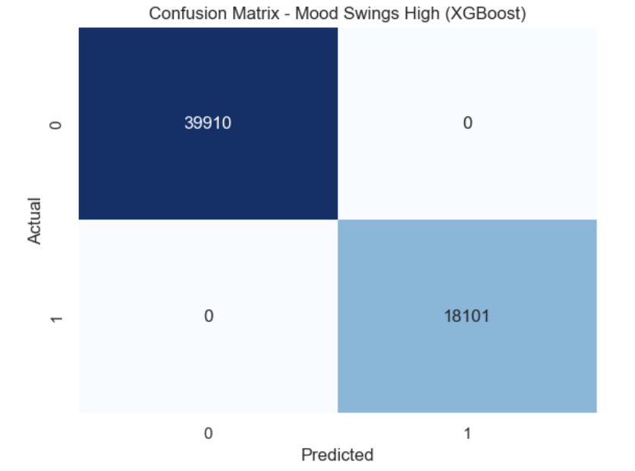
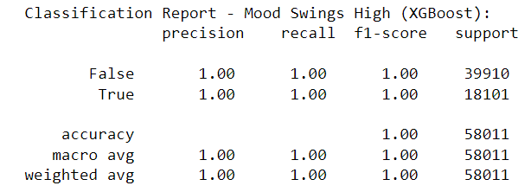

Selected Model – XGBOOST
For Mood Swings – High
MOOD SWINGS PREDICTION IN MENTAL HEALTH DATASET

Slide 17
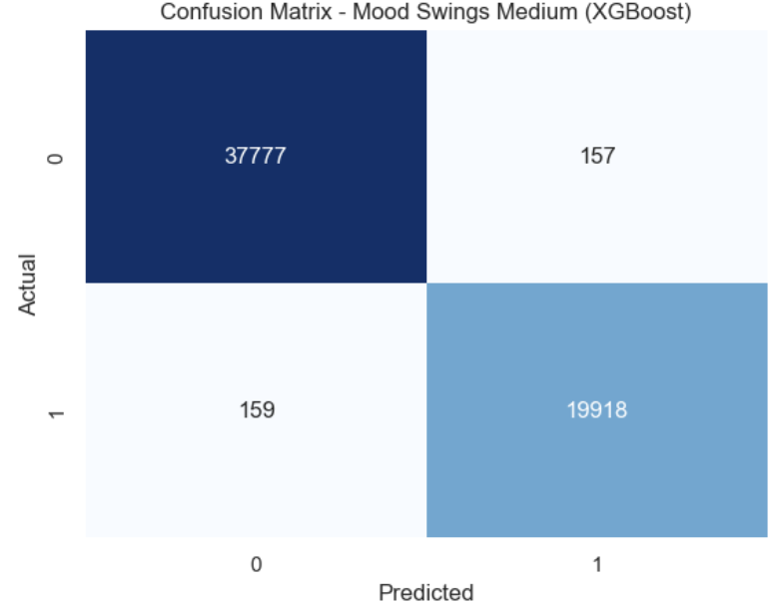
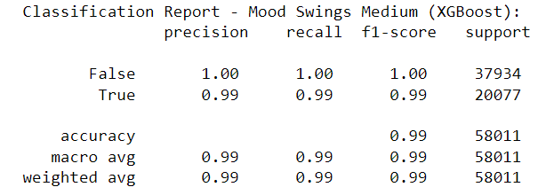
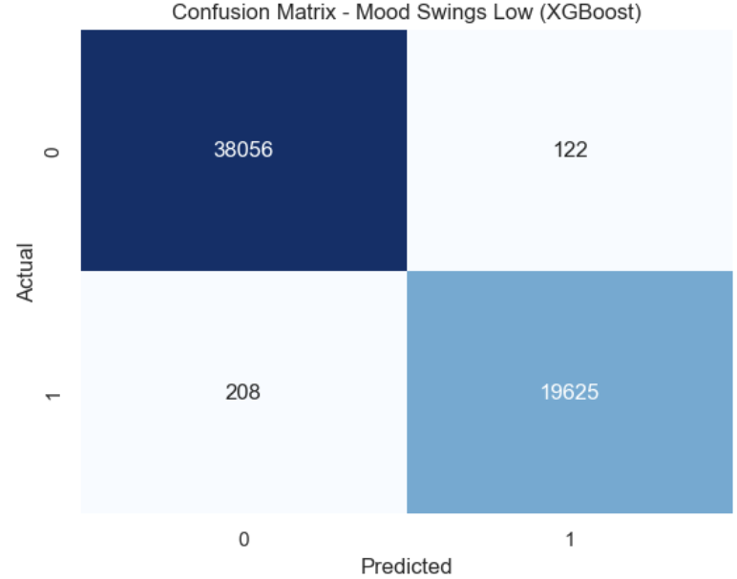
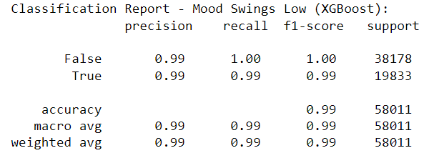
Selected Model – XGBOOST
For Mood Swings – Medium
MOOD SWINGS PREDICTION IN MENTAL HEALTH DATASET
For Mood Swings – Low

Slide 18

FINAL OBSERVATIONS
MOOD SWINGS PREDICTION IN MENTAL HEALTH DATASET
Approach and Objectives: The project utilized the Mental Health Dataset from Kaggle to develop a machine learning model to predict mood swings. Objectives included analyzing mental health indicators and predicting mood swings levels to aid in early diagnosis and treatment interventions.
Data Collection and Processing: Data was sourced from self-reported mental health surveys covering a broad demographic and various mental health conditions. The dataset initially contained 292,364 entries. After preprocessing, which involved handling missing values and removing duplicates, data integrity was maintained for robust analysis.
Model Development: The project explored multiple base classifiers, including LinearSVC, Logistic Regression, Naive Bayes, Random Forest, and XGBoost, to address multioutput classification. Key metrics like accuracy and ROC AUC were used to evaluate the models.
Validation and Model Selection: The model was validated using cross-validation techniques to ensure it generalizes well to unseen data. Performance metrics such as accuracy, precision, recall, and F1-score were utilized to evaluate the model's effectiveness. The XGBoost algorithm was chosen for its effectiveness in handling large datasets with a mixture of categorical and numerical data.

Slide 19

MOOD SWINGS PREDICTION IN MENTAL HEALTH DATASET
This project demonstrates the transformative potential of machine learning in enhancing the precision of mental health diagnostics. By harnessing the power of the XGBoost algorithm to accurately predict mood swings, we are setting the stage for more proactive, personalized, and effective mental health interventions. Our research underscores the critical role of data-driven insights in revolutionizing mental health care, ultimately leading to better patient outcomes and a deeper understanding of mental health dynamics.
Looking forward, the next steps involve expanding our model to incorporate additional predictive factors and datasets, potentially integrating real-time data from wearable technology. Continuous improvement of the model and its deployment in clinical settings can significantly aid in the early detection and tailored treatment of mental health issues, contributing to a broader societal impact on how we perceive and manage mental health.

Slide 20


Thank you
MOOD SWINGS PREDICTION IN MENTAL HEALTH DATASET
20

Slide 21

QUESTIONS?
MOOD SWINGS PREDICTION IN MENTAL HEALTH DATASET
21

